Slide 1

Shri Vaishnav Vidyapeeth Vishwavidyalaya
Data Visualisation and prediction using R
HAPINESS LEVEL PREDICTOR
Submitted to:Gaurav thulla Submitted by:
Abhay soni
deep shrivastav
Piyush nigam
Ritik dubey

Slide 2
PROJECT INTRODUCTION
This project uses data visualization and prediction on the taken data that gives the happiness rank and happiness score of 155 countries around the world based on seven factors including family, life expectancy, economy, generosity, trust in government, freedom, and dystopia residual. Sum of the value of these seven factors gives us the happiness score and the higher the happiness score, the lower the happiness rank. So, it is evident that the higher value of each of these seven factors means the level of happiness is higher. We can define the meaning of these factors as the extent to which these factors lead to happiness. Dystopia is the opposite of utopia and has the lowest happiness level.

Slide 3
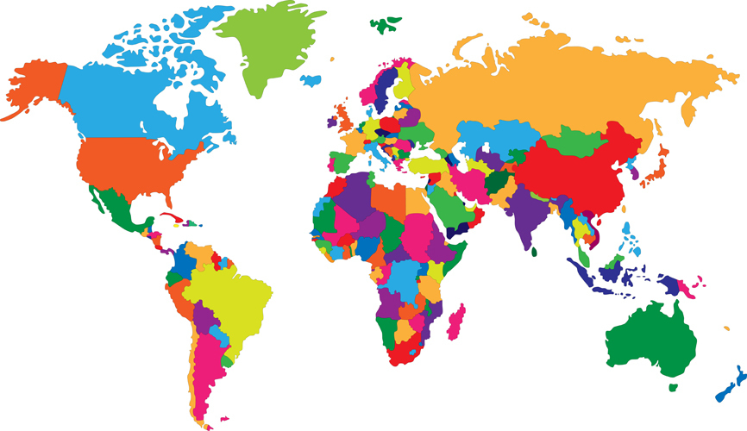

PROBLEM STATEMENT :
The purpose of choosing this work is to find out which factors are more important to live a happier life. As a result, people and countries can focus on the more significant factors to achieve a higher happiness level. We also will implement several machine learning algorithms to predict the happiness score and compare the result.

Slide 4
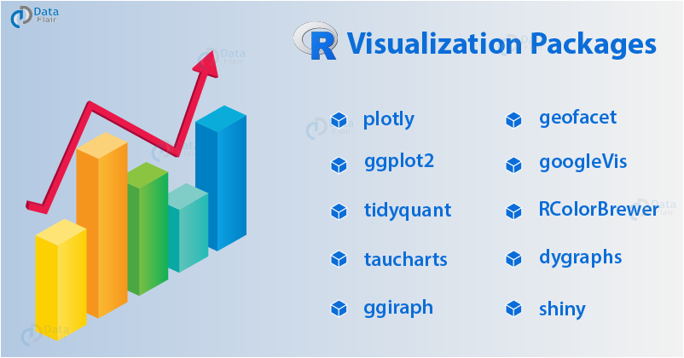
Technologies To Use:
R programming on r studio
Graphics libraries
Data mining
Data analysis and processing
Data visualization

Slide 5

Data We Would Be Working on
Dataset that we have chosen is Happiness 2017 dataset. This dataset gives the happiness score of 155 countries around the world.
This information include factors like family, life expectancy, economy, generosity, trust in government and freedom.
The database on which we would be working is in Comma Separated Values(.csv) format.

Slide 6

PROBLEM DESCRIPTION: The happiness scores and rankings use data from the Gallup World Poll. The scores are based on answers to the main life evaluation question asked in the poll. This question, known as the Cantril ladder, asks respondents to think of a ladder with the best possible life for them being a 10 and the worst possible life being a 0 and to rate their own current lives on that scale. The scores are from nationally representative samples for the years 2013-2016 and use the Gallup weights to make the estimates representative. The columns following the happiness score estimate the extent to which each of six factors – economic production, social support, life expectancy, freedom, absence of corruption, and generosity – contribute to making life evaluations higher in each country than they are in Dystopia, a hypothetical country that has values equal to the world’s lowest national averages for each of the six factors. They have no impact on the total score reported for each country, but they do explain why some countries rank higher than others

Slide 7

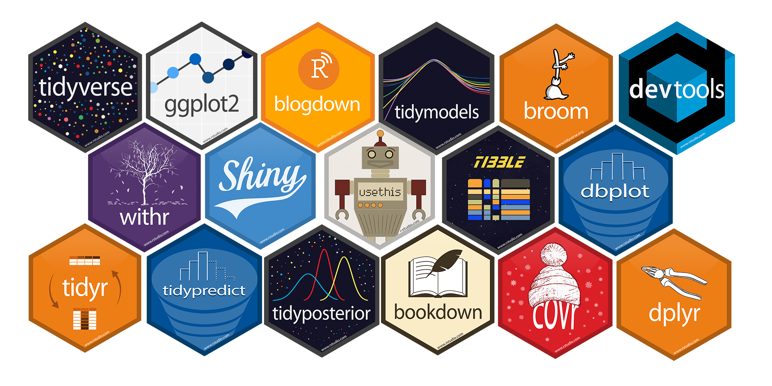

HOW WE ARE GETTING THERE : We are using multiple linear regression to mauplate and predict over the data. We are going to use data analysis, data processing data mining, data visualisation. For the purpose we have used R programming platform as R Studios for the purpose to get best job.

Slide 8
OUTCOME :
Analyse the effects of various factors like economy, trust on government and freedom on the happiness of people.
Analyse the data of Happiness survey and identify the role of various factors on the Happiness scores.
Better data visualisation over the record and dataset taken based on various categories modelled.
Prediction of the happiness level by using the various data factors.

Slide 9
THANK YOU !!

